Slide 1


USAGE FUNNELS PROJECT
ELIZABETH GRANDJOUAN
April 2020
Objective: Use SQL queries to retrieve data, creating and analyzing funnels. Conversion rates, A/B tests
Data Science Path. 4: Analyze Real Data with SQL

Slide 2
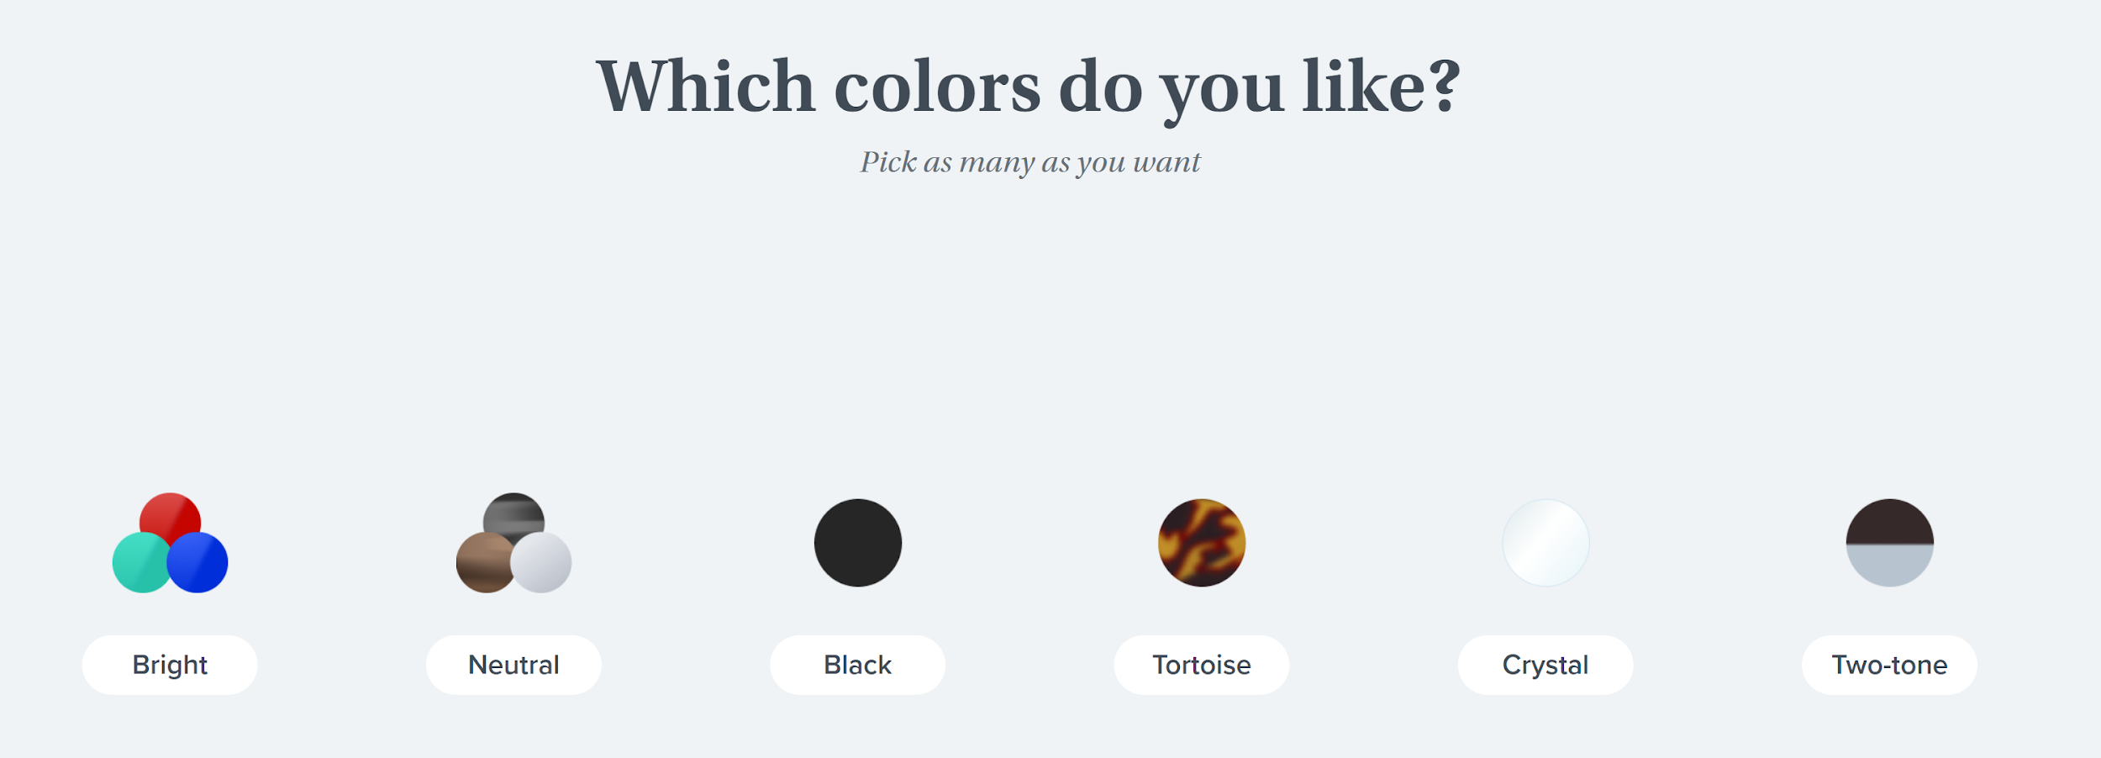
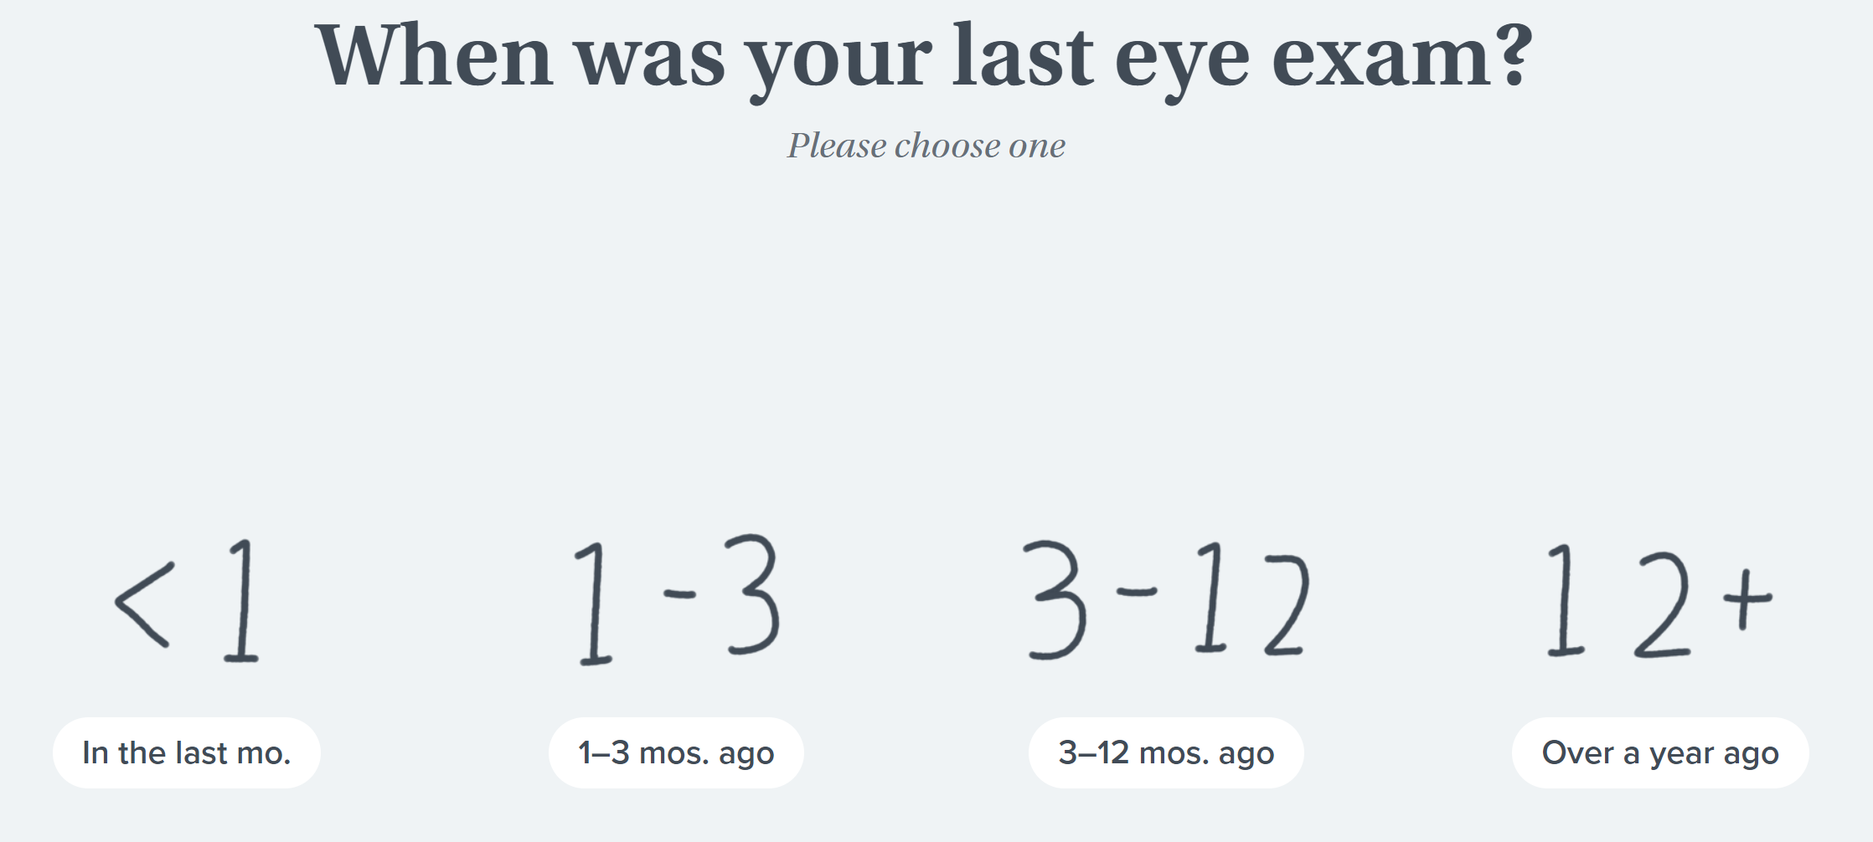
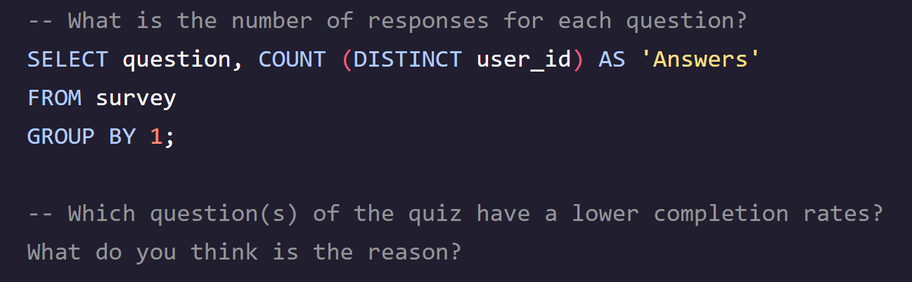
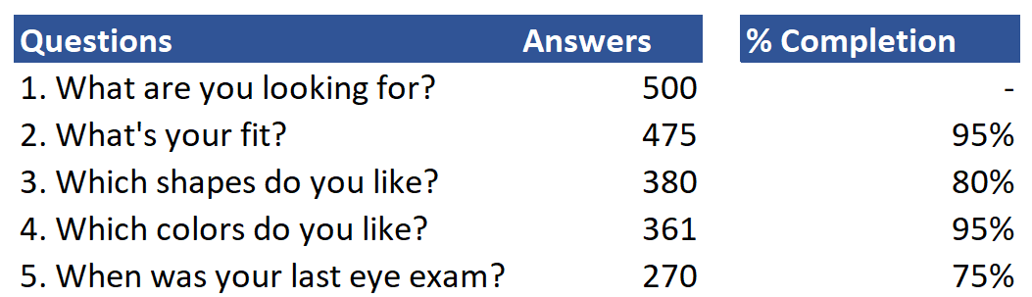

STYLE QUIZ FUNNEL (1)
questions and code:
lowest engagement - question 5
25% of users didn’t answer: reasons behind this could be the uncertainty of how this information is valuable in this survey, reluctance in sharing private information, unsuitable choice of options, tiredness of the length of the survey?
→ Actions: Explaining why Warby Parker asks for this information, reassuring that no data will be sold for marketing use, A/B testing the option choices, A/B testing engagement of users with removing this last question

Slide 3
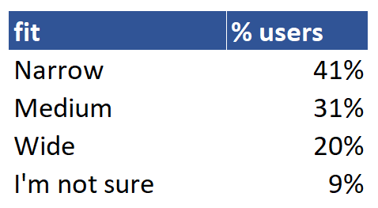
STYLE QUIZ FUNNEL (2)
improvement - question 2
2nd lowest engagement - question 3
The shape of glasses might be the most uncertain factor in this buying glasses process, and therefore the first factor behind the home-try-on trial, or users might not want to discard any option in order to try various styles
→ Actions: offering a multiple choice option, explaining that several shapes of glasses can be chosen afterwards in the test process
Question 2, “What’s your fit?”, has a high response rate (95%) but almost 1 out of 10 answers are uncertain. Could we add indication for users to be able to measure their fit?

Slide 4
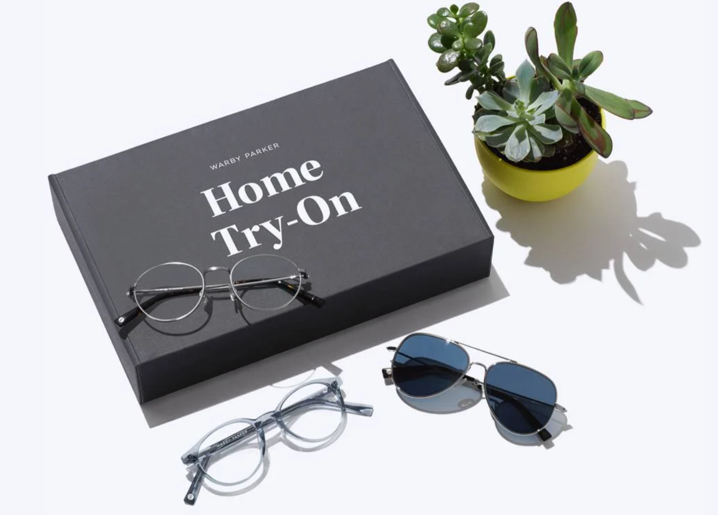
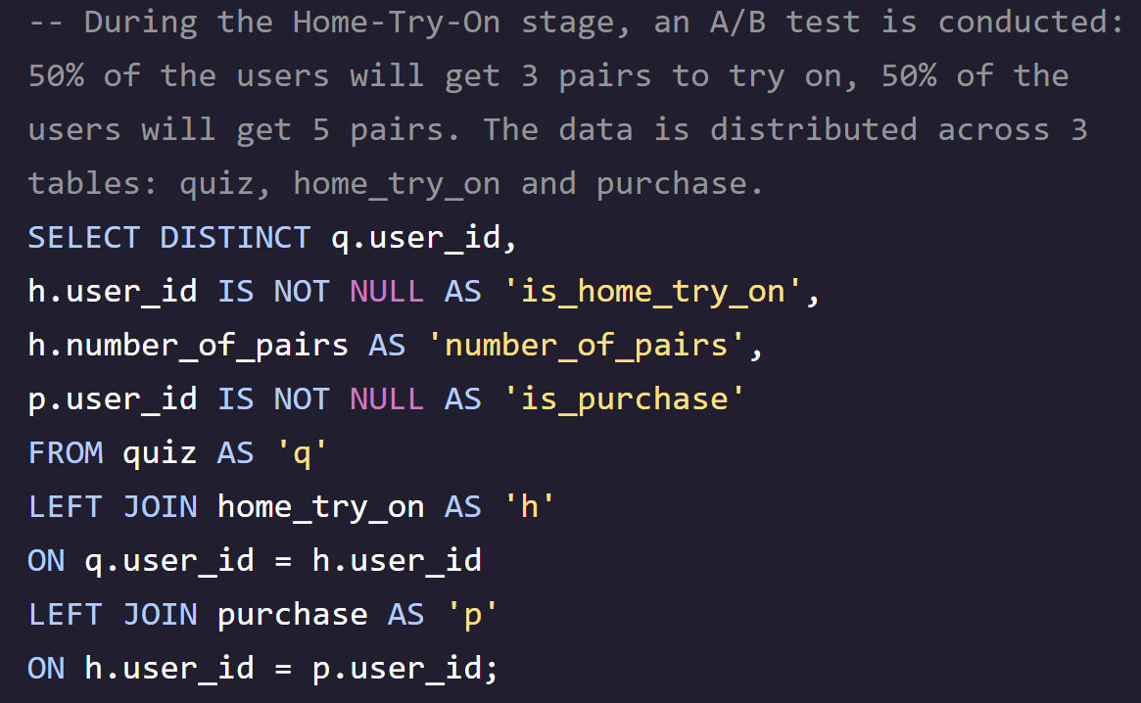
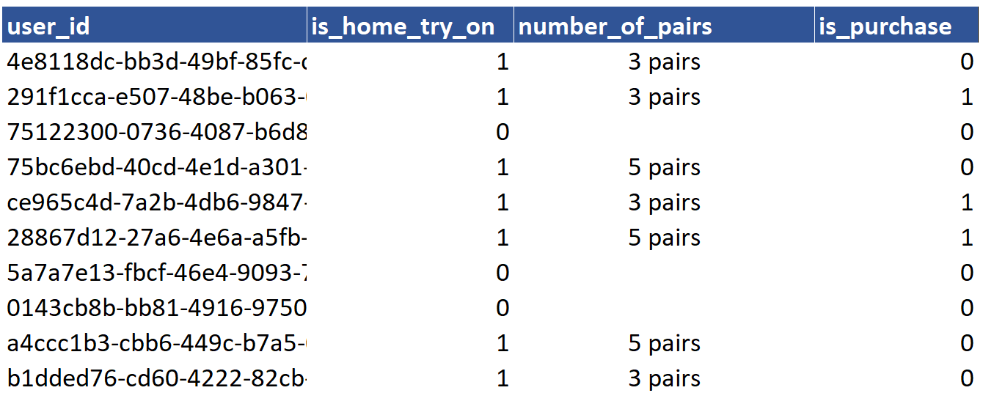
HOME-TRY-ON AND PURCHASE FUNNELS (1)
step 1 - How to optimise the data we currently have?
Top tips while creating this funnel:
Left joins are the most suitable solution there as we also want to see users who took the quiz but didn’t converted in a Home-Try-On test
Renaming the new columns is important for the data to be easily readable

Slide 5
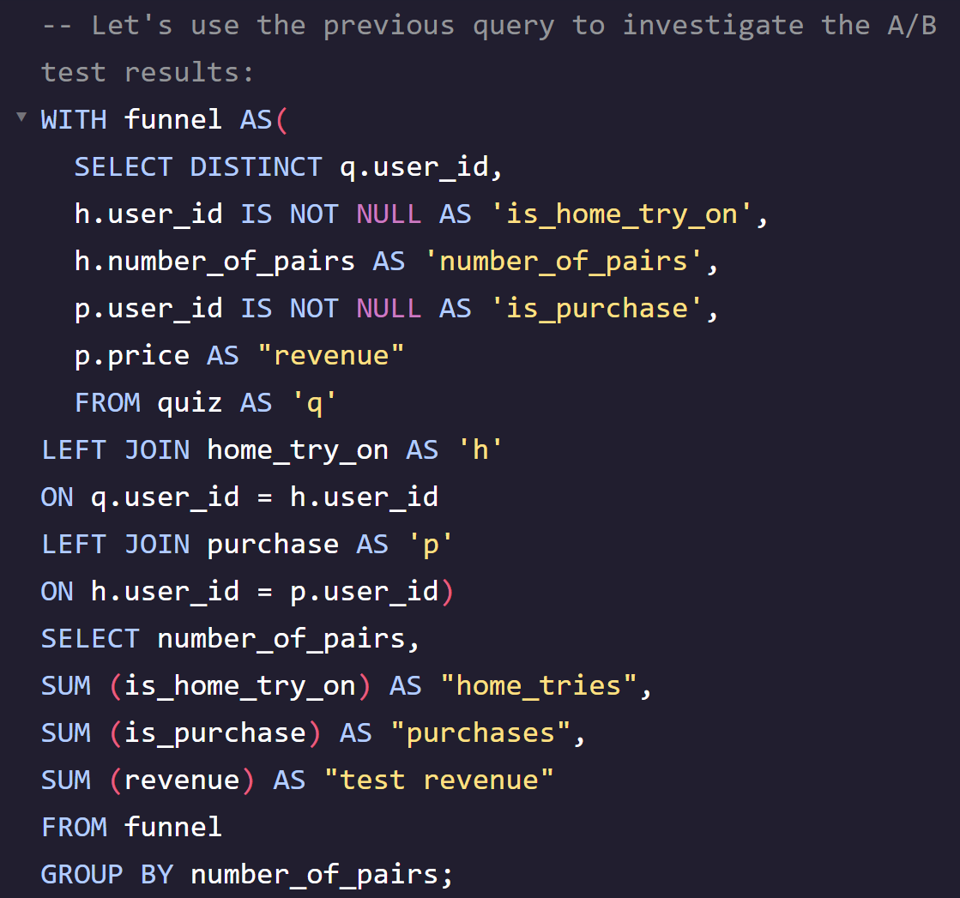
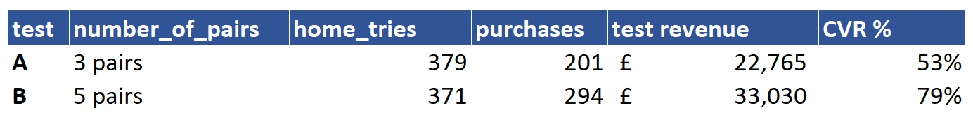
HOME-TRY-ON AND PURCHASE FUNNELS (2)
step 2 - What can we learn from this data?
CVR is much higher for variant group. Users receiving 5 pairs are 33% more likely to complete a purchase than 3 pairs-testers control group. Only half of control group are converting vs 79% of variant group.
The average revenue per purchase is similar for both user groups = £113
→ Test conclusions: The A/B test is successful for the variant group. Warby Parker would most likely experience an increase in purchases by moving 100% home-try-ons to 5 pairs tests

Slide 6
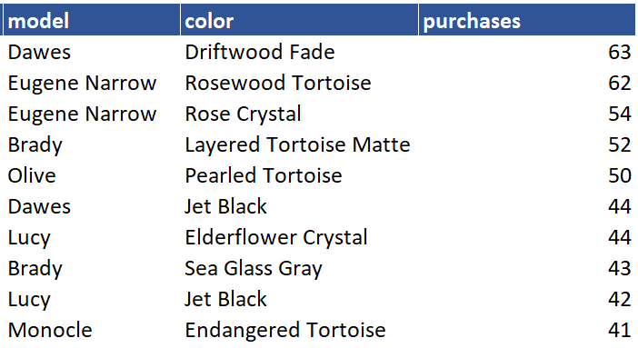
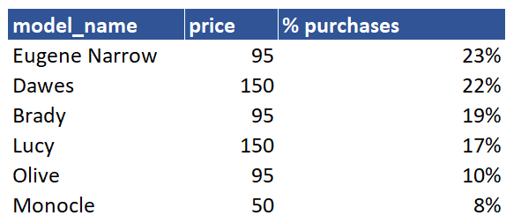
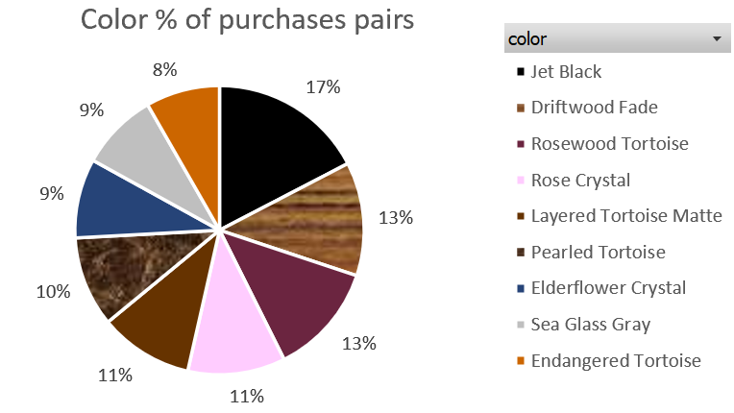
HOME-TRY-ON AND PURCHASE FUNNELS (3)
step 2 - What can we learn from this data?
Out of all purchases, 17% of pairs bought are black → best selling color
Monocle is the least purchased model of all: it is also the cheapest model by far → could Warby Parker test increasing the price of this product to expect higher conversion?
The top 2 combinations of model/color are:
Dawes model in driftwood fade
Eugene Narrow in rosewood tortoise

